Slide 1
Recommender System
IBM Data Science CAPSTONE

Slide 2
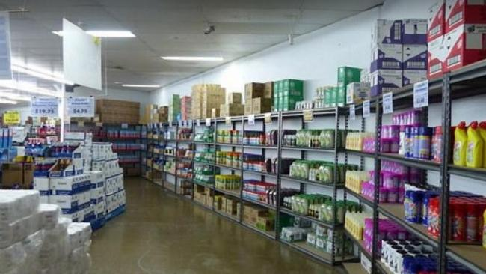
Introduction
The skills of a data scientist are not limited to any field rather, they can be used to solve real world problems using data analysis insights.
The location of the warehouse plays a very important role in the profits of the contractor.
A groceries contractor, therefore, needs to be very decisive with where he places one of his warehouses.
However, there are many factors which he needs to take into consideration to maximize his clients and therefore his profits.

Slide 3
Assumptions
All types of groceries are sold
All restaurants require all types of groceries
Food joints are considered as restaurants

Slide 4

Data Requirements
[Postal Code]
[Neighborhood(s)]
[Neighborhood Latitude]
[Neighborhood Longitude]
[Venue] [Venue Summary]
[Venue Category]
[Distance (meter)]

Slide 5
Methodology
Gather Data
Data collection of all the neighborhoods in the desired borough
Connect API
Connect Foursquare API and extract venue data and fliter using the list of neighborhoods in the Borough
Data Prepping
Prep the Data for an initial EDA and using One-Hot Encoding of the venue categories for the ML model
Choose Model
Choose the correct type of model ie Clustering, Classification, etc
Results
Getting the results and visualizing the insights

Slide 6
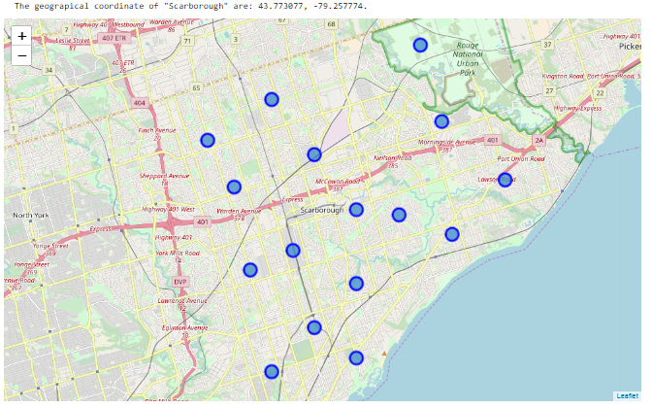
Neighborhoods in Scarborough

Slide 7
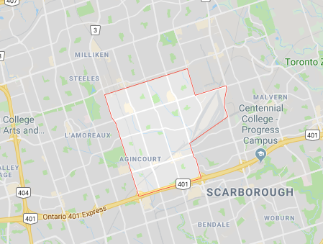
Recommendation based on analysis

